Slide 1
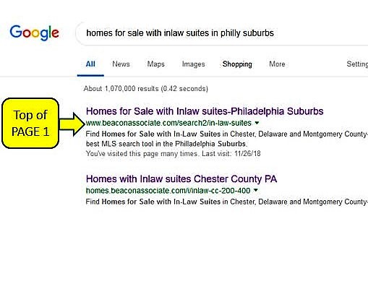
Do you know that your home with an In-law suite … does NOT show in the results of a search for homes with In-law Suites?
Why can’t Buyers looking for In-law Suites find your Home
The Janine McVeigh Team
We are a team of Philadelphia Suburban Realtors who specialize in helping buyers find homes with “In-law Suites”. Our Web Site showing homes for sale with “In-law” suites appears at or near the top of the first page of Google search results. We welcome the opportunity to show you how our experience and emphasis on technology can sell your home.
--
Need more proof...
Try Googling “Homes for Sale with Inlaw Suites
Philly Suburbs.”
My Team at
www.beaconassociate.com
has been specializing in this market for years!

Slide 2
If you have a home with an “In-law” suite and it is not selling … Please read this.
Let me show you how My Team can help!
Call now: 610-608-4452
Email: Janine.McVeigh@gmail.com
Janine McVeigh, Realtor®
1000 Germantown Pike, Suite A5
Plymouth Meeting, PA 19462
Mr. Thomas McVeigh
50 Beacon Hill Drive
Phoenixville, Pa. 19460
Janine McVeigh
Realtor®
Let us help you find, or market, your dream home!

